Slide 1
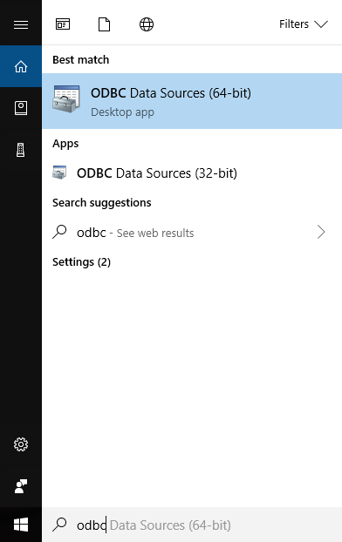
Create ODBC connection in Windows 10
First, simply search ODBC in windows 10 and select the version corresponding with your system. For example, my system is a 64-bit

Slide 2
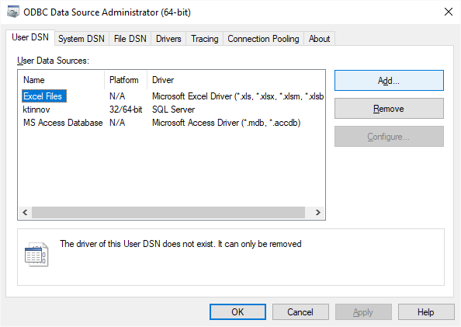
Create ODBC connection in Windows 10
Next simply add a new connection with your database’s information and your credentials

